Slide 1
We are Nhân phẩm team
Hello !!!

Slide 2
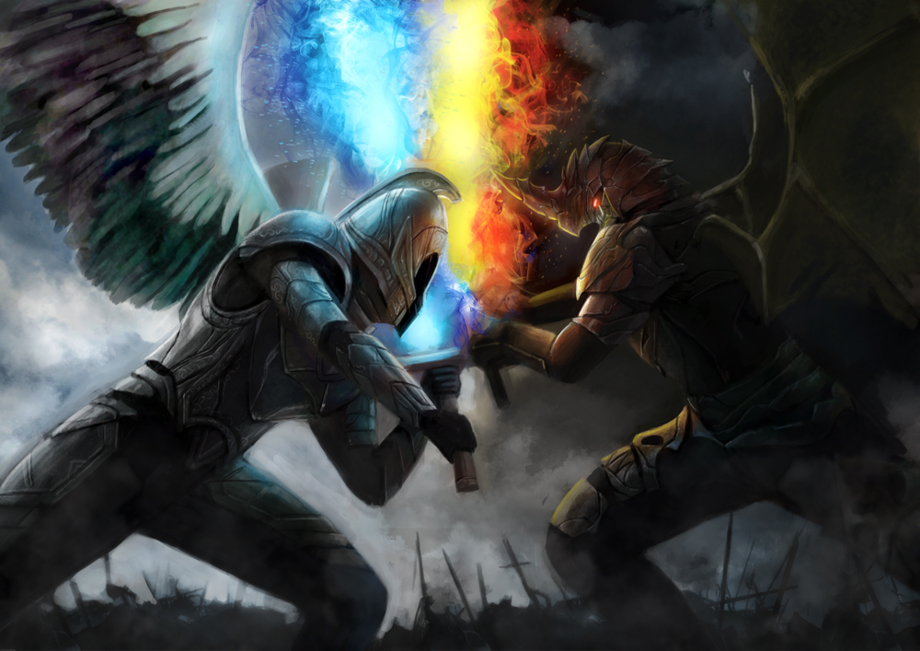
Rise of Evil
A game 2D isometric defense where you build an army and defend
all the attack of evils to save the world.

Slide 3
1.
Goal set

Slide 4

A game can be played
Easy to build Tower
Hard to win
Have monsters can attack Tower
Have many type of Tower
As long monster live as less money it gives when be killed

Slide 5
2.
Gameplay

Slide 6
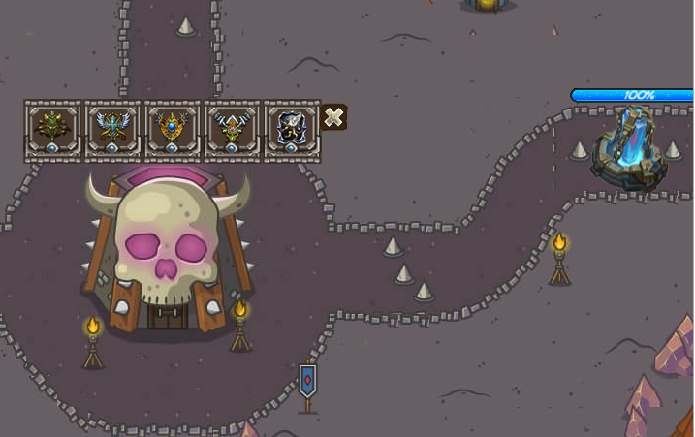
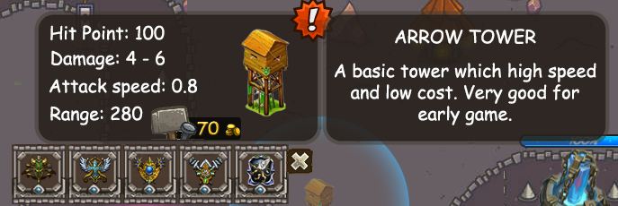
Touch any where on ground to open
build Menu
Then touch on Tower Icon
to see details of that Tower

Slide 7
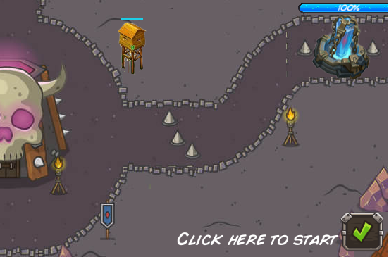
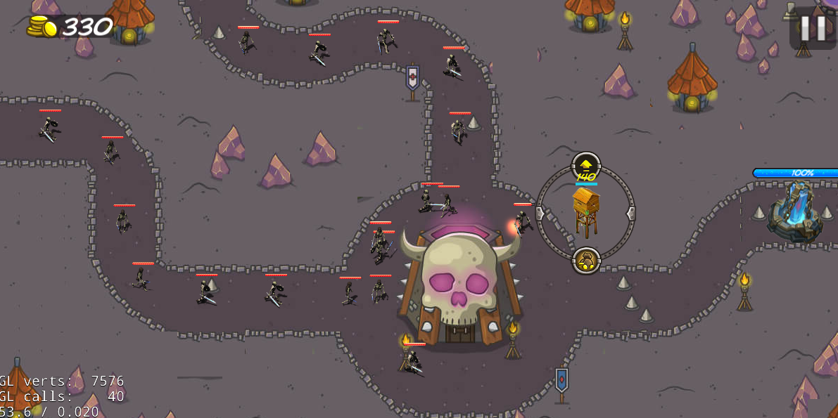
Click start to begin the game
Then just play like a normal game,
Build or upgrade when necessary

Slide 8
3.
TIPs

Slide 9
Tower up to level 3 will have special skill.
Try to kill monster as fast as you can to earn more money.
The first time Crystal burst will lead you to Boss wave, avoid it.
The combination between Slow or Barrack tower and Boombard tower is very good to clear monster.

Slide 10

Thanks!
Any questions?
Contact my team.

